Slide 1
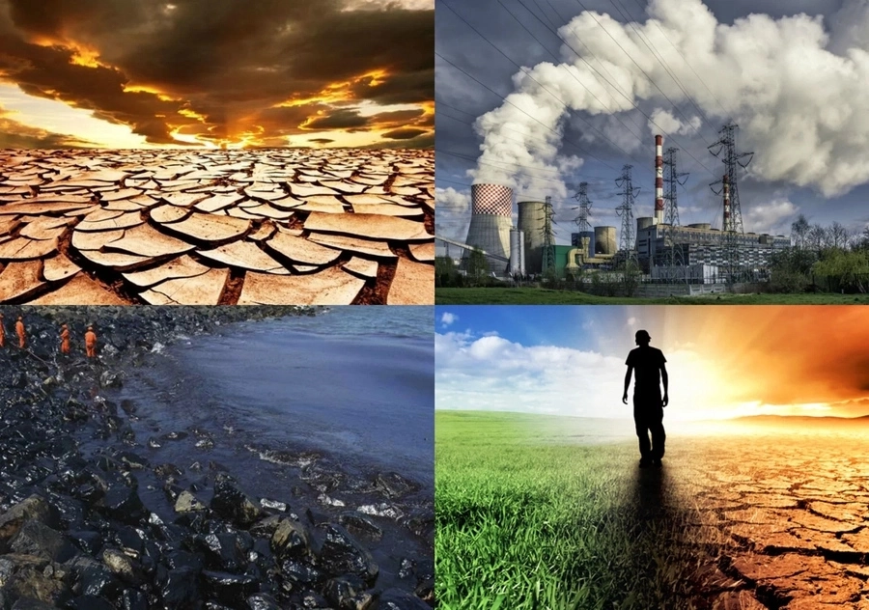
ENVIRONMENTAL PROBLEMS

Slide 2
Environmental Problems
Environmental issues are defined as problems with the planet’s systems (air, water, soil, etc.) that have developed as a result of human interference or mistreatment of the planet.”

Slide 3
Environmental Problems
1. Pollution 2. Soil Degradation 3. Global Warming 4. Overpopulation 5. Natural Resource Depletion 6. Generating Unsustainable Waste 7. Waste Disposal 8. Deforestation 9. Polar Ice Caps 10. Loss of Biodiversity | 11. Climate Change 12. Ocean Acidification 13. The Nitrogen Cycle 14. Ozone Layer Depletion 15. Acid Rain 16. Water Pollution 17. Overfishing 18. Urban Sprawl 19. Public Health Issues 20. Genetic Engineering

Slide 4
1. POLLUTION
There are 7 key types of pollution – air, water, soil, noise, radioactive, light and thermal and these are primary causes that affect our environment in many ways. All these types of pollution are interlinked and influence each other. Therefore we need to tackle all of them together.
Pollution of air, water and soil requires millions of years to recoup. Industry and motor vehicle exhaust are the number one pollutants. Heavy metals, nitrates and plastic are toxins responsible for pollution.
While water pollution is caused by oil spill, acid rain, urban runoff, air pollution is caused by various gases and toxins released by industries and factories and combustion of fossil fuels;
soil pollution is majorly caused by industrial waste that deprives soil from essential nutrients.

Slide 5
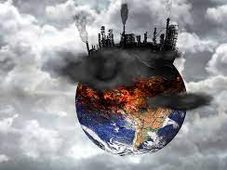
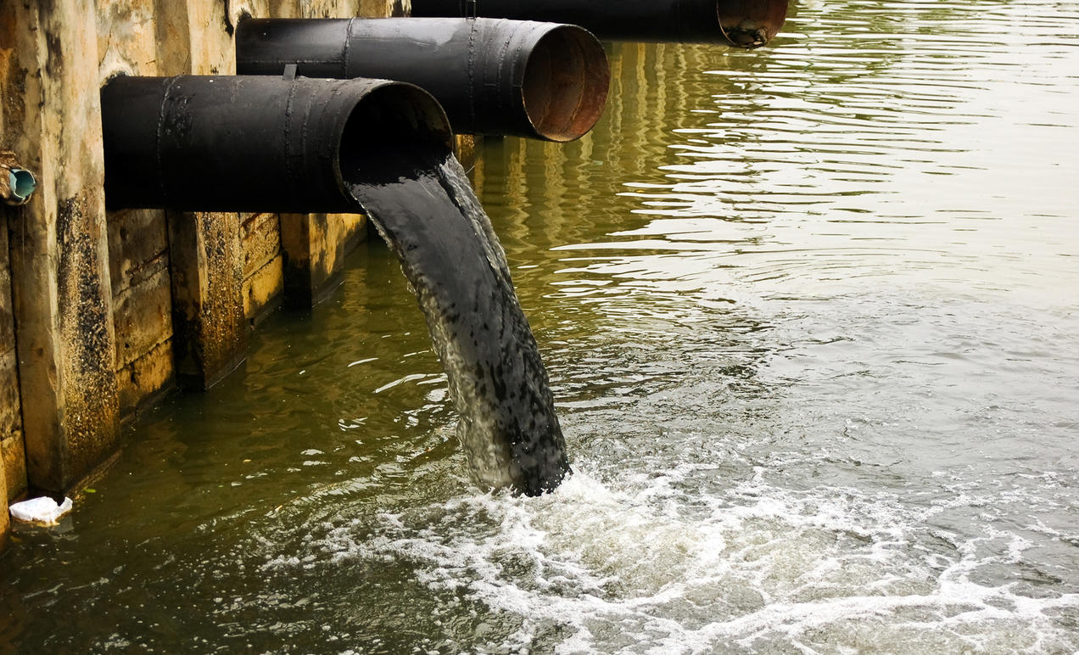
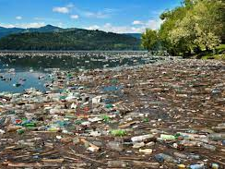

Slide 6
2. Soil Degradation
Globally, food security depends on the factor whether or not soils are in good condition to produce crops. According to UN estimates, about 12 million hectares of farmland a year get seriously degraded.
Soils get damaged due to many reasons. Such reasons include erosion, overgrazing, overexposure to pollutants, monoculture planting, soil compaction, land-use conversion and many more.
Nowadays, a wide range of techniques of soil conservation and restoration exist, from no-till agriculture to crop rotation to water-retention through terrace-building.

Slide 7
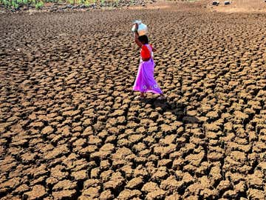
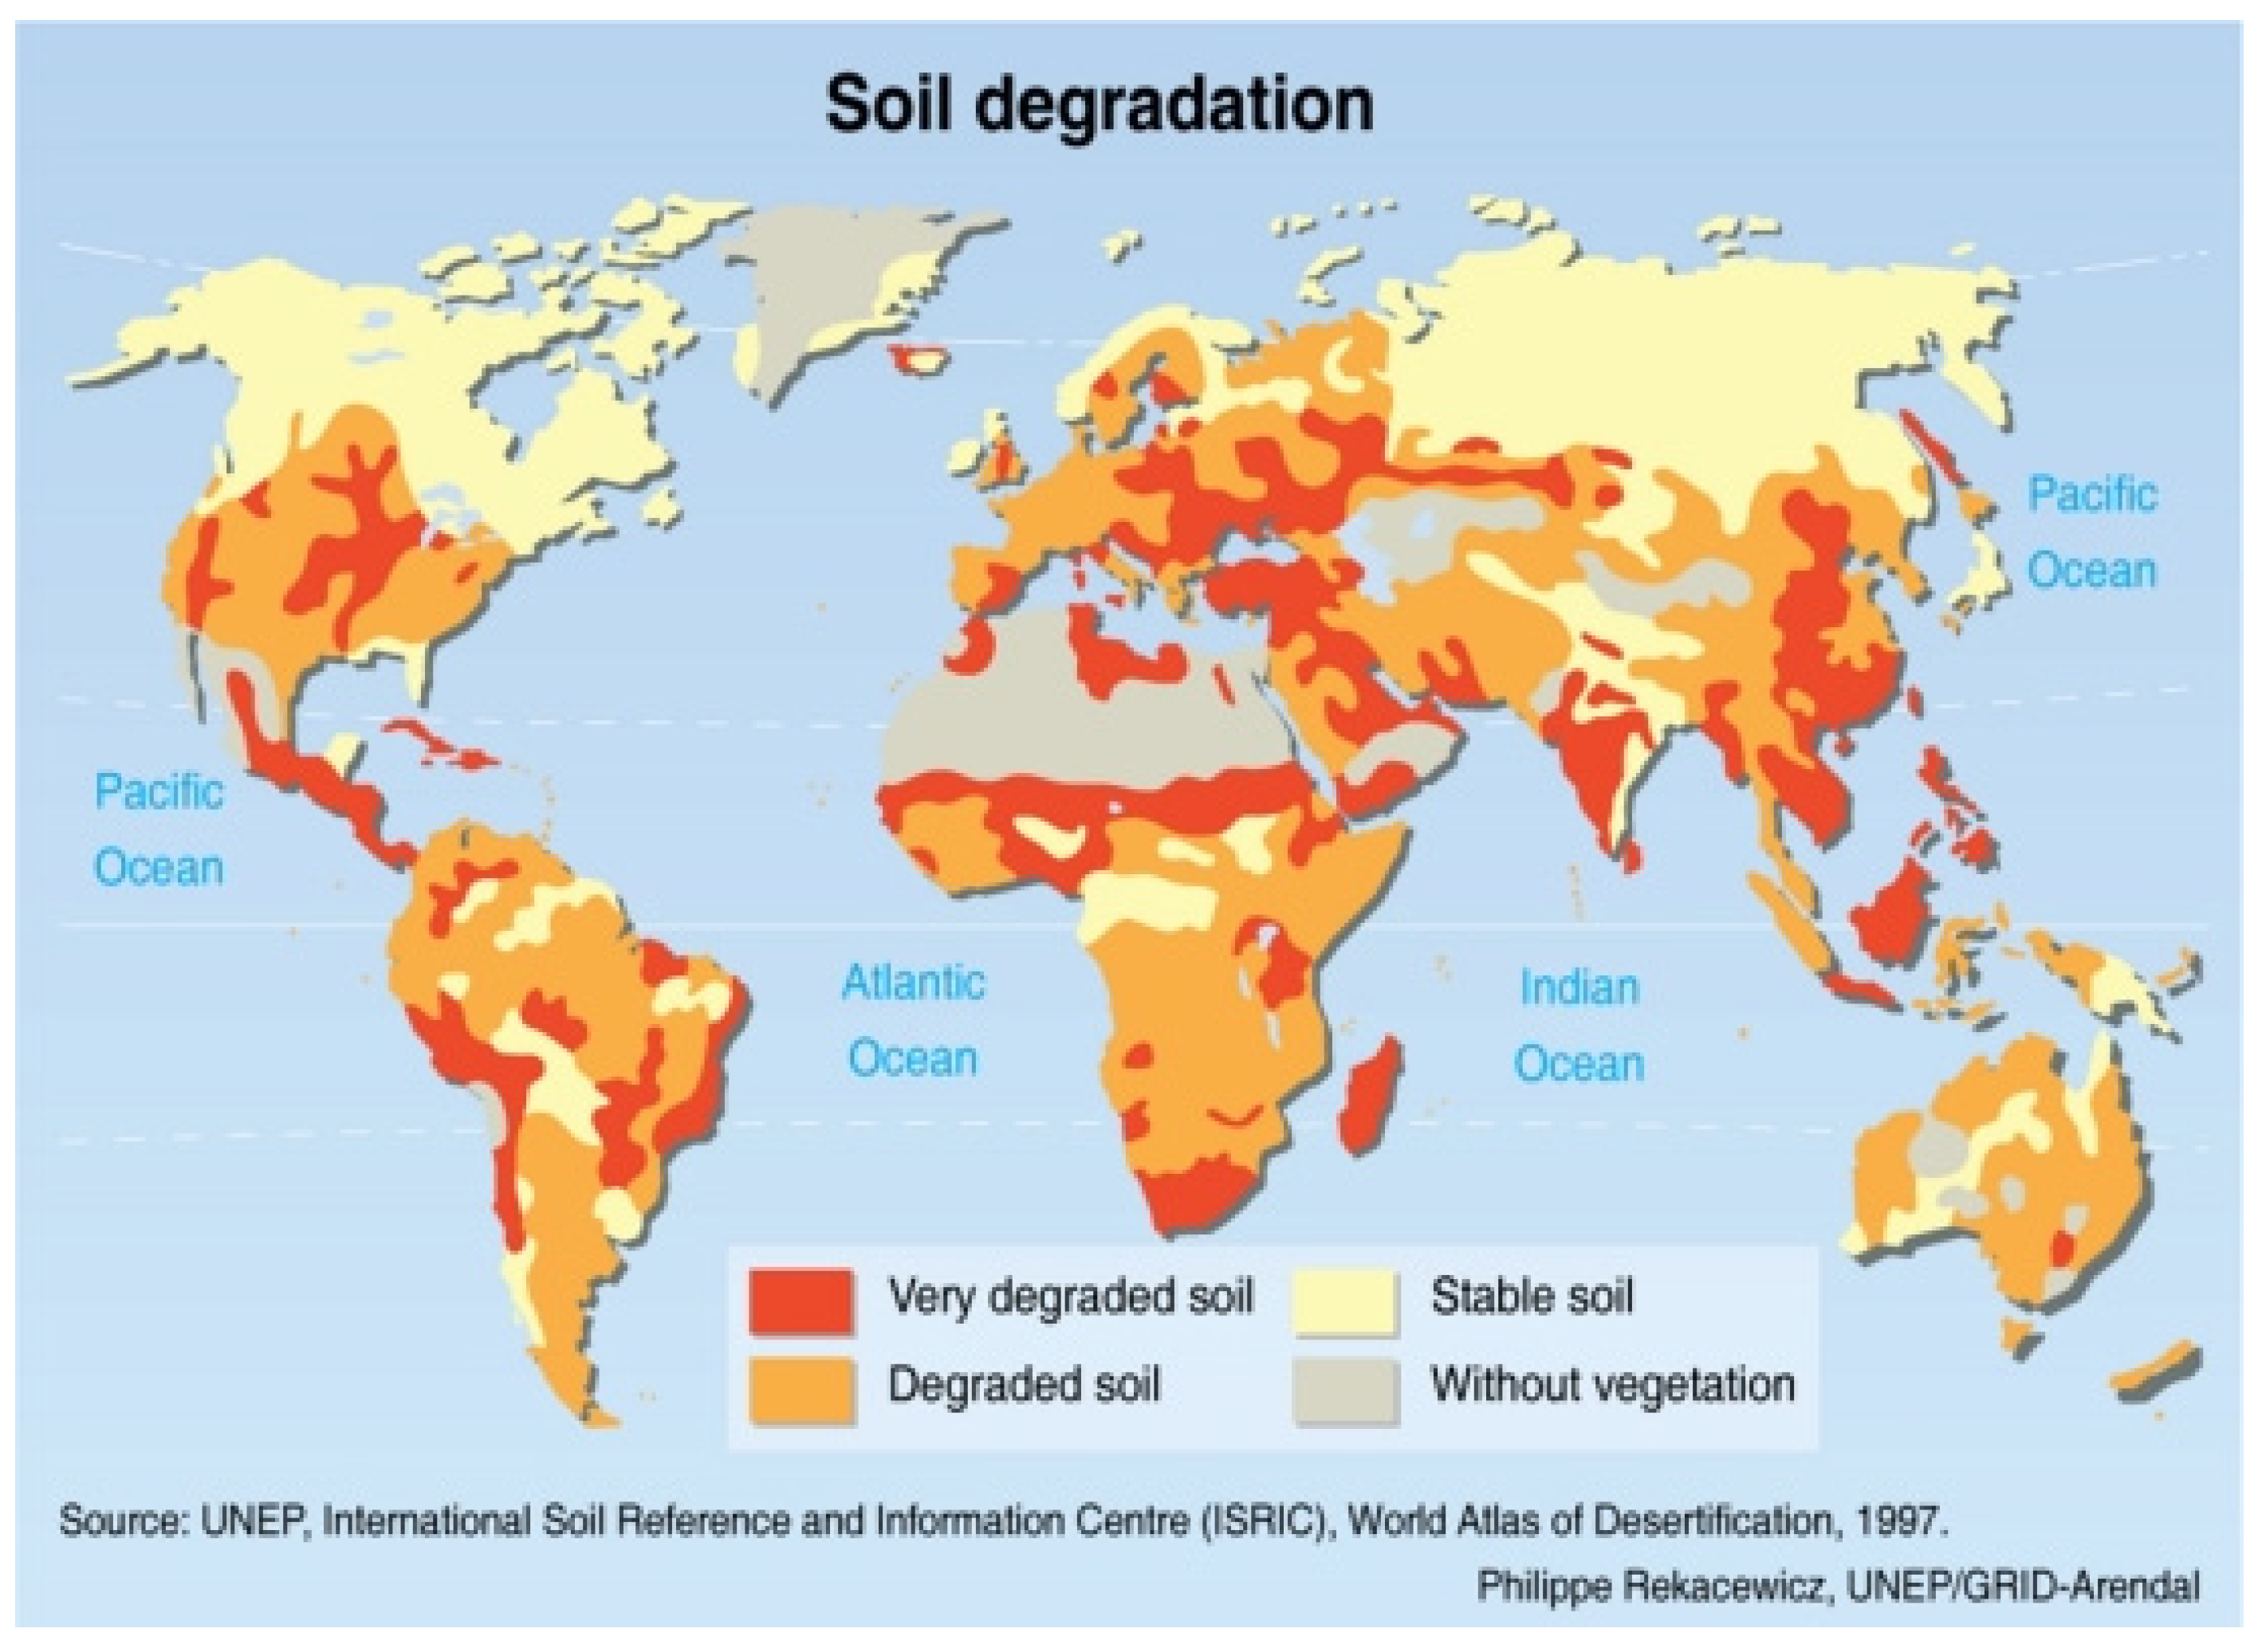
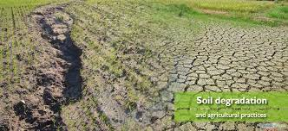

Slide 8
3. Global Warming
Climate changes like global warming are the result of human practices like the emission of greenhouse gases.
Global warming leads to rising temperatures of the oceans and the earth’ surface causing natural disasters that include flooding, melting of polar ice caps, rise in sea levels and also unnatural patterns of precipitation such as flash floods, hurricanes, wildfires, drought, excessive snow or desertification.

Slide 10
4. Overpopulation
The population of the planet is reaching unsustainable levels as it faces a shortage of resources like water, fuel and food. Population explosion in less developed and developing countries is straining the already scarce resources.
Intensive agriculture practiced to produce food damages the environment through the use of chemical fertilizer, pesticides and insecticides.
Overpopulation is also one of the crucial current environmental problems.

Slide 12
5. Natural Resource Depletion
Another crucial current environmental problem is the depletion of Natural resources. We, humans, use so many natural resources that it would need almost 1.5 Earths to cover all our needs.
This will further increase in the future due to massive industrialization in Asian countries like India and China. Increased use of natural resources leads to a number of other environmental issues, such as industrialization, population growth and air pollution.
Over time, natural resource depletion will lead to an energy crisis. The chemicals emitted from many natural resources contribute to climate change. Fossil fuel consumption results in the emission of greenhouse gases, which is primarily responsible for global warming and climate change.
Globally, people are making efforts to shift to renewable sources of energy like solar, wind, biogas and geothermal energy. As such, the cost of installing the infrastructure and maintaining these sources has plummeted in recent years.

Slide 13
6. Generating Unsustainable Waste
The huge production of waste due to our hyperconsumption is a major threat to the environment. As per the study, the average person produces 4.3 pounds of waste per day, and the US alone accounting for 220 million tons a year.
This hyperconsumption results in non-biodegradable trash in the form of plastic packaging, toxic e-waste, and harmful chemicals that leach into our waterways.
When this waste ends up in landfills, it generates enormous amounts of methane, which ranks as one of the worst greenhouse gases because of its high potential for global warming. It creates severe explosion hazards.
Since modern technology allows us to access digital environments, many things that you need can be fulfilled in the cloud. Consider your purchases carefully.

Slide 14
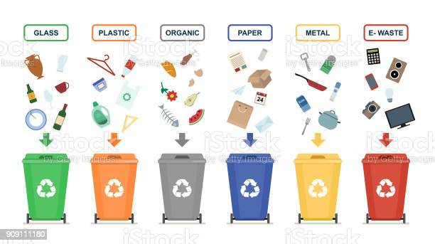
7. Waste Disposal

Slide 15
7. Waste Disposal
The overconsumption of resources and the creation of plastics are creating a global crisis of waste disposal. Developed countries are notorious for producing an excessive amount of waste or garbage and dumping their waste in the oceans and less developed countries.
Nuclear waste disposal has tremendous health hazards associated with it. Plastic, fast food, packaging and cheap electronic wastes threaten the well being of humans.
Waste disposal is, therefore, one of the urgent current environmental problems.

Slide 16
8. Deforestation

Slide 17
8. Deforestation
Our forests are natural sinks of carbon dioxide and produce fresh oxygen, as well as helps in regulating temperature and rainfall. At present, forests cover 30% of the land, but every year tree cover is lost, amounting to the country of Panama due to the growing population demand for more food, shelter and cloth.
Deforestation simply means clearing of green cover and make that land available for residential, industrial or commercial purposes.

Slide 18
9. Polar Ice Caps

Slide 20
9. Polar Ice Caps
The issue of the melting of polar ice caps is a contentious one. Although NASA studies have shown that the amount of ice in Antarctica is increasing, however, this increase is only one-third of what is being lost in the Arctic.
There is enough evidence that shows sea levels are rising, and the melting of Arctic ice caps is a major contributor. Over time, the melting of polar ice caps could lead to extensive flooding, contamination of drinking water and major changes in ecosystems.

Slide 21
10. Loss of Biodiversity
The existence of a number of different kinds of animals and plants which together make a good and healthy environment.

Slide 22
10. Loss of Biodiversity
Human activity is leading to the extinction of species and habitats and loss of biodiversity. Ecosystems, which took millions of years to perfect, are in danger when any species population is decimating.
Balance of natural processes like pollination is crucial to the survival of the ecosystem, and human activity threatens the same.
Another example is the destruction of coral reefs in the various oceans, which support the rich marine life.

Slide 23
11. Climate Change
Climate change is yet another environmental problem that has surfaced in the last couple of decades. It occurs due to the rise in global warming, which happens due to the increase in temperature of the atmosphere by burning fossil fuels and the release of harmful gases by industries.
Climate change has various harmful effects but not limited to the melting of polar ice, change in seasons, occurrence of new diseases, frequent occurrence of floods and change in overall weather scenario.

Slide 24
12. Ocean Acidification

Slide 25
12. Ocean Acidification
It is a direct impact of excessive production of CO2. 25% of total atmospheric CO2 is produced by humans.
The ocean acidity has increased by the last 250 years, but by 2100, it may shoot up by 150%. The main impact is on shellfish and plankton in the same way as human osteoporosis.

Slide 28
WHAT EXACTLY IS THE NITROGEN CYCLE?
The nitrogen cycle is a repeating cycle of processes during which nitrogen moves through both living and non-living things: the atmosphere, soil, water, plants, animals and bacteria.
.In order to move through the different parts of the cycle, nitrogen must change forms. In the atmosphere, nitrogen exists as a gas (N₂), but in the soils it exists as nitrogen oxide, NO, and nitrogen dioxide, NO₂, and when used as a fertilizer, can be found in other forms, such as ammonia, NH₃, which can be processed even further into a different fertilizer, ammonium nitrate, or NH₄NO₃.
There are five stages in the nitrogen cycle,
fixation or volatilization, mineralization, nitrification, immobilization, and denitrification.

Slide 29
NITROGEN IS KEY TO LIFE!
Nitrogen is a key element in the nucleic acids DNA and RNA
Deoxyribonucleic acid, a self-replicating material which is present in nearly all living organisms as the main component of chromosomes, and carrier of genetic information.
Ribonucleic acid, a nucleic acid present in all living cells, acts as a messenger carrying instructions from DNA.
which are the most important of all biological molecules and crucial for all living things.
DNA carries the genetic information, which means the instructions for how to make up a life form.
When plants do not get enough nitrogen, they are unable to produce amino acids (substances that contain nitrogen and hydrogen and make up many of living cells, muscles and tissue). Without amino acids, plants cannot make the special proteins that the plant cells need to grow. Without enough nitrogen, plant growth is affected negatively.
With too much nitrogen, plants produce excess biomass, or organic matter, such as stalks and leaves, but not enough root structure. In extreme cases, plants with very high levels of nitrogen absorbed from soils can poison farm animals that eat them

Slide 30
NITROGEN IMPORTANCE ??
By mole fraction (i.e., by number of molecules), dry air contains 78.08% nitrogen, 20.95% oxygen, 0.93% argon, 0.04% carbon dioxide, and small amounts of other gases. Air also contains a variable amount of water vapor, on average around 1% at sea level, and 0.4% over the entire atmosphere.
Usually, Composition of the 4 most abundant gases are:
Nitrogen (N₂) - 78.084%
Oxygen (O₂) - 20.9476%
Argon (Ar) - 0.934%
Carbon dioxide (CO₂) 0.0314%
Nitrogen is a fundamental component of amino acids, which are the molecular building blocks of protein.

Slide 31
THUS
Understanding how the plant-soil nitrogen cycle works can help us make better decisions about what crops to grow and where to grow them, so we have an adequate supply of food.
Knowledge of the nitrogen cycle can also help us reduce pollution caused by adding too much fertilizer to soils.
Certain plants can uptake more nitrogen or other nutrients, such as phosphorous, another fertilizer, and can even be used as a “buffer,” or filter, to prevent excessive fertilizer from entering waterways.
For example, a study done by Haycock and Pinay showed that poplar trees (Populus italica) used as a buffer held on to 99% of the nitrate entering the underground water flow during winter, while a riverbank zone covered with a specific grass (Lolium perenne L.) held up to 84% of the nitrate, preventing it from entering the river.

Slide 33
14. Ozone Layer Depletion
When chlorine and bromine atoms come into contact with ozone in the stratosphere, they destroy ozone molecules. One chlorine atom can destroy over 100,000 ozone molecules before it is removed from the stratosphere. Ozone can be destroyed more quickly than it is naturally created.
The ozone layer is an invisible layer of protection around the planet that protects us from the sun’s harmful rays.
The depletion of the crucial Ozone layer of the atmosphere is attributed to pollution caused by Chlorine and Bromide found in Chloro-fluoro carbons (CFCs).
Once these toxic gases reach the upper atmosphere, they create a hole in the ozone layer, the biggest of which is above the Antarctic.

Slide 34
15. Acid Rain
Acid rain is rain or any other form of precipitation that is unusually acidic, meaning that it has elevated levels of hydrogen ions (low pH).
Most water, including drinking water, has a neutral pH that exists between 6.5-8.5, but acid rain has a pH level lower than this and ranges from 4-5 on average.[
The more acidic the acid rain is, the lower its pH is.
Acid rain can have harmful effects on plants, aquatic animals, and infrastructure.
Acid rain is caused by emissions of sulphur dioxide and nitrogen oxide, which react with the water molecules in the atmosphere to produce acids.
Acid rain occurs due to the presence of certain pollutants in the atmosphere. Acid rain can be caused due to combustion of fossil fuels or erupting volcanoes or rotting vegetation which releases sulfur dioxide and nitrogen oxide into the atmosphere.
Acid rain has been shown to have adverse impacts on forests, freshwaters, and soils, killing microbes, insects and aquatic life-forms, causing paint to peel, corrosion of steel structures such as bridges, and weathering of stone buildings and statues as well as having impacts on human health

Slide 35
Acid rain can have severe effects on vegetation.
A forest in the Black Triangle in Europe

Slide 36
Acid Rain And Weathering

Slide 37
Acid Rain And Weathering

Slide 38
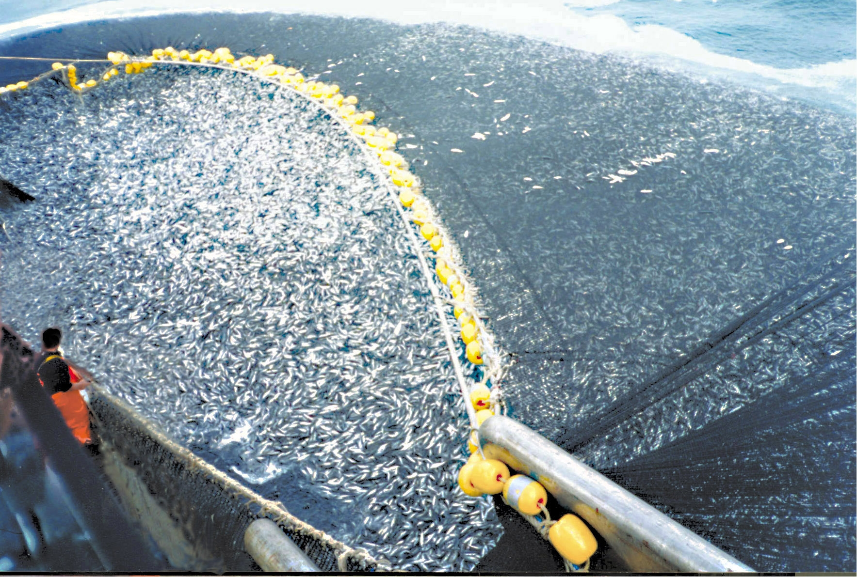
17. Overfishing

Slide 39
17. Overfishing
Overfishing is the removal of a species of fish from a body of water at a rate greater than that the species can replenish its population naturally, resulting in the species becoming increasingly underpopulated in that area
Overfishing affects natural ecosystems severely and leads to an imbalance of ocean life. Around 63% of global fish stocks are estimated to be overfished.
Overfishing caused fishing fleets to migrate to new waters that would further deplete the fish stocks.
Moreover, it has negative effects on coastal communities that rely on fishing to support their living.

Slide 40
16. Water Pollution
Water pollution (or aquatic pollution) is the contamination of water bodies, usually as a result of human activities, in such a manner that negatively affects its legitimate uses.
Water pollution results when contaminants are introduced into these water bodies.
Water pollution can usually be attributed to one of four sources: sewage, industry, agriculture, and urban runoff including stormwater.
For example, releasing inadequately treated wastewater into natural waters can lead to degradation of these aquatic ecosystems.
Water pollution can also lead to water-borne diseases for people using polluted water for drinking, bathing, washing or irrigation.

Slide 41
16. Water Pollution
Pollution may take the form of toxic substances (e.g., oil, metals, plastics, pesticides, persistent organic pollutants, industrial waste products),
Stressful conditions (e.g., changes of pH, hypoxia or anoxia, stressful temperatures, excessive turbidity, unpleasant taste or odor, and changes of salinity), or pathogenic organisms.
Control of water pollution requires appropriate infrastructure and management plans as well as legislation.
Technology solutions can include improving sanitation, sewage treatment, industrial wastewater treatment, agricultural wastewater treatment, erosion control, sediment control and
Control of urban runoff .Effective control of urban runoff includes reducing speed and quantity of flow.

Slide 42
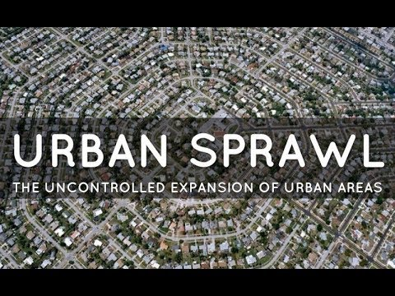
18. Urban Sprawl

Slide 43
18. Urban Sprawl
Causes of Urban Sprawl
Lower Land Rates. ...
Improved Infrastructure. ...
The Rise in Standard of Living. ...
Lack of Urban Planning. ...
Lack of Proper Laws that can Regulate Urban Planning. ...
Lower House Tax Rates. ...
The Rise in Population Growth. ...
Consumer Preferences.

Slide 44
18. Urban Sprawl
urban sprawl, also called sprawl or suburban sprawl, the rapid expansion of the geographic extent of cities and towns, often characterized by low-density residential housing, single-use zoning, and increased reliance on the private automobile for transportation.
Urban sprawl results in land degradation, increased traffic, environmental issues and health issues.
Greater air pollution contributes to higher asthma and other lung disorder rates.
An increased dependence on the automobile encourages a more sedentary lifestyle and can potentially contribute to obesity.
The increased danger and stress of long commutes can lead to more accidents, anxiety, and social isolation.
The ever-growing demand for land displaces the natural environment consisting of flora and fauna, instead of being replaced.

Slide 45
18. Urban Sprawl
Transit-oriented development, in which higher-density mixed-use areas are permitted or encouraged near transit stops, is encouraging more compact development in certain areas: particularly those with light and heavy rail transit systems.
Bicycles are the preferred means of travel in many countries: Also, bicycles are permitted in public transit.
Businesses in areas of some towns in which bicycle use is high are thriving. Bicycles and transit contribute in two important ways toward the success of businesses:
People living the closest to these business districts on average have more money to spend locally because they spend less on their cars.
Because such people rely more on bicycling, walking, and transit than on driving, they tend to focus more of their commerce on locally-owned neighborhood businesses that are convenient for them to reach.

Slide 46
18. Urban Sprawl
Land use policies are one potential avenue to reduce the effects of urban sprawl. These policies take the form of boundaries to urban growth, regional development rights, and development centralized in urban cities. Housing policies, such as inclusionary zoning, rental vouchers in suburban areas, and a focus on employer-assisted housing are another approach to combatting urban sprawl. Gasoline taxes and increased funding towards the construction of public transportation also help to reduce the necessity of commuting in and out of urban areas.
Walkability is a measure of how friendly an area is to walking. Walkability has many health, environmental, and economic benefits.
However, evaluating walkability is challenging because it requires the consideration of many subjective factors. design.
Factors influencing walkability include the presence or absence and quality of footpaths, sidewalks, or other pedestrian right-of-ways, traffic and road conditions, land use patterns, building accessibility, and safety, among others.
Walkability is an important concept in sustainable urban development plan

Slide 47
19. Public Health Issues
The current environmental problems pose a lot of risk to the health of humans and animals. Dirty water is the biggest health risk in the world and poses a threat to the quality of life and public health.
Runoff to rivers carries with it toxins, chemicals and disease-carrying organisms. Pollutants cause respiratory diseases like Asthma and cardiac-vascular problems. High temperatures encourage the spread of infectious diseases like Dengue.

Slide 48
In 2019, the top 10 causes of death accounted for 55% of the 55.4 million deaths worldwide.
The top global causes of death, in order of total number of lives lost, are associated with three broad topics: cardiovascular (ischaemic heart disease, stroke), respiratory (chronic obstructive pulmonary disease, lower respiratory infections) and neonatal conditions – which include birth asphyxia and birth trauma, neonatal sepsis and infections, and preterm birth complications.

Slide 51
20. Genetic Engineering
Genetic modification of food using biotechnology is called genetic engineering. Genetic modification of food results in increased toxins and diseases as genes from an allergic plant can transfer to the target plant. Genetically modified crops can cause serious environmental problems as an engineered gene may prove toxic to wildlife.
Another drawback is that increased use of toxins to make insect resistant plants can cause resultant organisms to become resistant to antibiotics.
The need for change in our daily lives and the movements of our government is growing. Since so many different factors come into play, such as voting, governmental issues, the desire to stick to a routine, many people don’t consider that what they do will affect future generations.
If humans continue moving forward in such a harmful way towards the future, then there will be no future to consider. Although it’s a fact that we cannot physically stop our ozone layer from thinning (and scientists are still having trouble figuring out what is causing it exactly), there are still so many things we can do to try and put a dent in what we already know.

Slide 52
QUICK REVISION

